Slide 1

ENGLISH
4to. Medio A-B
Miss. Viviana Munizaga L.
Unit 1: The media and the message in today's globalized world
Activity nº1: The impact of social issues today
1° Part of the unit deadline: 31st March 2020

Slide 2



INTRODUCTION
Purpose of the unit:
Esta actividad permite que los estudiantes aprendan a escribir un informe acerca de temas sociales. Para ello ejercitarán el campo léxico y la estructura de este tipo de texto para luego escribir su propio informe en base a la información dada en un video.
Learning goal:
Produce clear oral and written texts in contexts related to their interests and concerns, in order to express a critical personal opinion that respects other opinions.
Use their knowledge of English in the comprehension and production of clear oral and written texts, in order to build a critical personal opinion in contexts related to their interests and concerns.

Slide 3
Lesson 1
En esta clase debes trabajar Sólo 45 minutos.
Objetivo a desarrollar Reading Comprehension y writing
Lee atentamente y desarrolla las actividades según se explican.
Envíame las respuestas de la primera parte al correo vihema23@Gmail.com (Miss Viviana) a través de este ppt hasta el 31 de marzo.
Se adjunta rúbrica de evaluación en cada una de tus actividades
Recuerda que son actividades de proceso, por lo que debes procurar hacer tus ejercicios y reenviármelos en el tiempo solicitado.

Slide 4
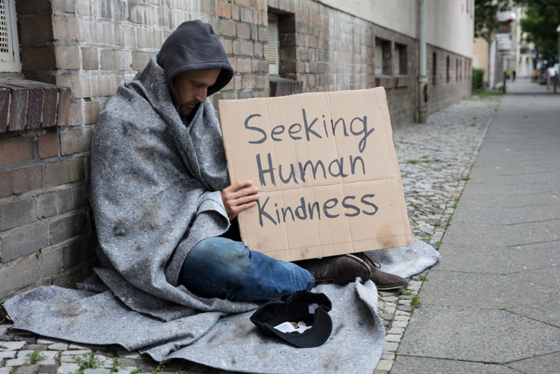
Content of the Unit:
Activity 1 (formative evaluation se realizará en dos semanas):
Read a report about homelessness.
Write a report based on the structure given in a video.

Slide 5
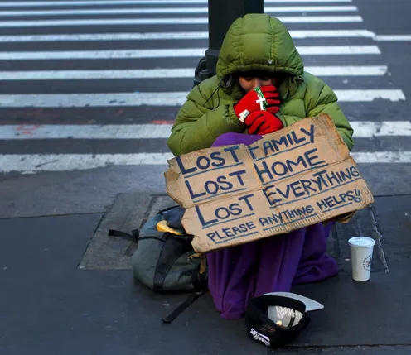

Activity 1: The impact of social issues today
INSTRUCTIONS:
First, You will read a short report about the problems experienced by street citizens in the United States. Before reading think of this:
Poverty and the seek of equality in today's society…

Slide 6
Discuss the following questions. Take notes in the spaces.
1. What are the reasons why a person can be homeless? (2 Marks) For your answer, consider the following concepts:
income – unemployment – catastrophe – debt – support.
___________________________________________________________________________________________________________________________________________________________________________________________________________________________________________________________________________________________________________________________
2. What do you think is the impact of experiencing homelessness on adults and children? (2 Marks)
For your answer, consider the following concepts:
quality of life – physical and mental health – nutrition – hygiene – self-esteem – education and school success.
____________________________________________________________________________________________________________________________________________________________________________________________________________________________________________________________________________________________________________________________________________________

Slide 7
3. Now, according to your answers organize all the information that you have, and make a diagram like in the following example:
  Include all the information that is shown in the diagram.
Do it in the next page…

Slide 8

3. Draw your diagram…(3 Marks)

Slide 9
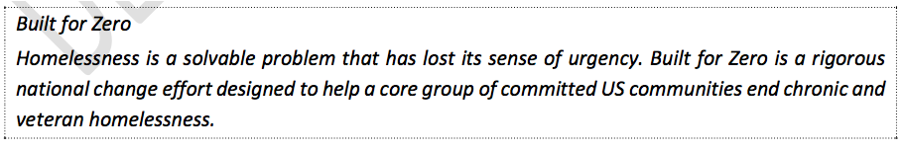

I. Now you are going to read a report which advertises what has been done in a community to help homeless people in the United States.
BEFORE READING
Read the following summary of the text and extract the main idea.
Take these words into account before reading…

Slide 10
READING:

Slide 13
AFTER READING:
4. Match the following words to the correct definition. Try NOT to use the dictionary.(4 marks)
A. Core group 1. ____ indispensable persons or things
B. Data 2. ____ that there is a solution to it
C. To spread 3. ____ To cover an area
D. Tipping point 4. ____ Numbers, percentages , etc.
E. Solvable 5.____The average of time a person or group of people will live for
F. Life Expectancy 6. ____The time at which a change or an effect cannot be stopped
G. To face 7. ____To confront
H. Housing 8. ____Places to live in

Slide 14

Let’s see how much you learnt!
Write 2 key questions you would ask a student about a section of the article “Built for Zero” with the corresponding answers: (8 Marks / 2 marks each)
Questions about paragraphs 1 and 2.
Questions about paragraphs 3 and 4.
Questions about paragraphs 5 and 6.
Questions about paragraphs 7 and 8.

Slide 15
5. Questions about paragraphs 1 and 2.( 2 Marks)
_____________________________________________________________________________?
_____________________________________________________________________________
_____________________________________________________________________________?
_____________________________________________________________________________
6. Questions about paragraphs 3 and 4. ( 2 Marks)
_____________________________________________________________________________?
_____________________________________________________________________________
_____________________________________________________________________________?
_____________________________________________________________________________

Slide 16
7. Questions about paragraphs 5 and 6.( 2 Marks)
_____________________________________________________________________________?
_____________________________________________________________________________
_____________________________________________________________________________?
_____________________________________________________________________________
8. Questions about paragraphs 7 and 8. ( 2 Marks)
_____________________________________________________________________________?
_____________________________________________________________________________
_____________________________________________________________________________?
_____________________________________________________________________________

Slide 17

REFLEXION
Now, discuss the following:
9. Which actions do you know have been taken in your communities to help homeless people? Have they been successful? (1 Mark)
_______________________________________________________________________________________________________________________________________________________________________________________________________________________________________________________________

Slide 18
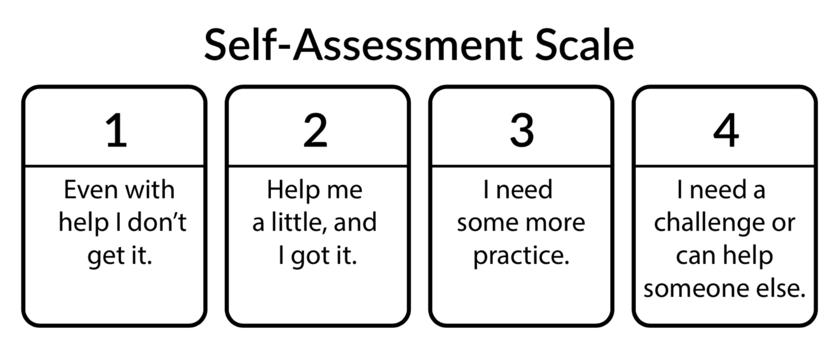
N° ACTIVITY | SCORE
1 | 2 MARK
2 | 2 MARK
3 | 3 MARK
4 | 4 MARK
5 | 2 MARK
6 | 2 MARK
7 | 2 MARK
8 | 2 MARK
9 | 1 MARK
TOTAL | 20
Mark with a (x) this self- evaluation scale to know better what you really need.

Slide 19
