Slide 1
Verbs followed by gerund or infinitive

Slide 2
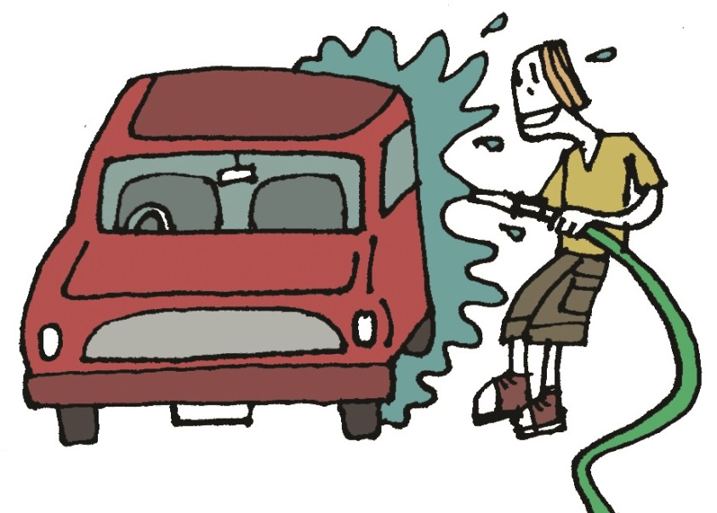
Verbs followed by the gerund
The gerund
=
verb
+
-ing
help
ing
I you clean the car.
don’t mind
helping
We were told to avoid going to the lake because it’s dangerous.
He suggested rescuing the cat with a ladder.

Slide 3
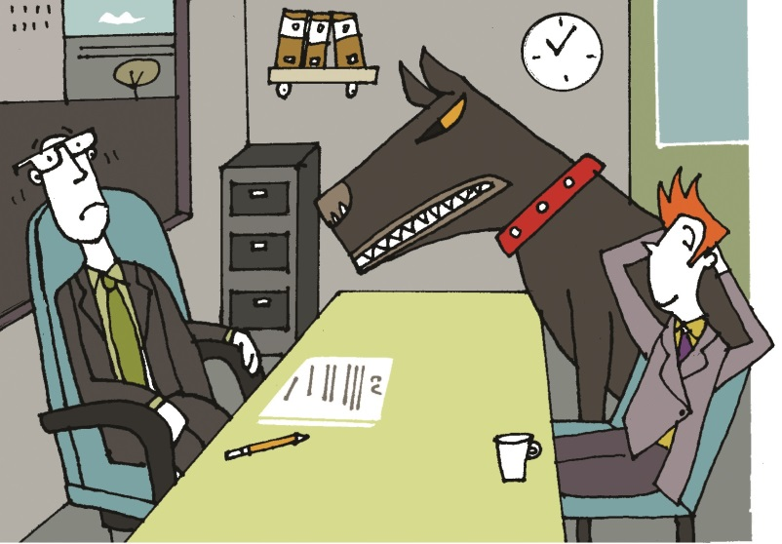
Verbs followed by the infinitive
The infinitive
=
to
+
the base form of the verb
to
have
They an informal chat about the job.
wanted
to have
The teacher decided to give us extra homework.
We can’t afford to buy that present – it’s too expensive.

Slide 4
promise
expect
(can’t) stand
(don’t) mind
Verbs followed by the gerund | Verbs followed by the infinitive
finish, imagine, feel like, practise, avoid, | hope, learn, decide, offer,
(don’t) mind,
promise,
expect,
afford,
choose,
(can’t) stand,
enjoy,
feel like,
want
enjoy
suggest
want
feel like
suggest
choose
afford

Slide 5

GET IT RIGHT!
I don’t mind to go home first.
I’d like telling you something.
I enjoyed meet your friends. They’re really nice.
I don’t mind going home first.
I’d like to tell you something.
I enjoyed meeting your friends. They’re really nice.

Slide 6
Language in action
Many people can’t stand , (fly) and this story may make you feel like (take) the bus or train! On January 15, 2009, a flight took off from New York's LaGuardia Airport. There were 155 people on board. A flock of birds hit the plane and it lost power to both engines.
Pilots practise (land) on water (on computers) but experts say that it’s almost impossible. This pilot (Chesley B. Sullenberger III) hoped . (prove) the experts wrong and when he saw the Hudson River below, he decided (land) the plane on the water to avoid ……………. (crash) into houses and buildings. He saved the lives of everyone on board.
flying
taking
landing
to prove
to land
crashing

Slide 7
Can you remember the rules?
Some verbs in English are followed by to + infinitive and some are followed by a gerund (the -ing form of the a verb).
Some common verbs followed by to + infinitive are:
The show’s too expensive – I can’t afford to go.
The other player’s really good, so I don’t expect to win the match.
You need to learn to control yourself and not get so angry.
I promise to be there on time.
afford,
choose,
decide,
expect,
hope,
learn,
offer,
promise,
want.

Slide 8
Can you remember the rules?
Some verbs in English are followed by a gerund (the -ing form). Common verbs are:
That park’s a bit dangerous, so we avoid going there.
I don’t want to work any more – I feel like doing something to enjoy myself.
I can’t imagine living in a foreign country.
Do you ever miss seeing your friends when you travel?
avoid,
enjoy,
feel like,
finish,
imagine,
(don’t) mind,
miss,
practise,
suggest.

Slide 9
Find someone who: Name
… can’t stand eating a certain food item. ________
… doesn’t mind getting up early. ________
… hopes to go to university. ________
… wants to watch a film this weekend. ________
… feels like playing football after school. ________
… avoids tidying their bedroom. ________
… can afford to go to the cinema with you. ________
… has decided what they want to do when they ________
are older.

Slide 10
Plan a dialogue
Plan a party with entertainment and food for a friend’s birthday.
Verb suggestions:
(don’t) mind, suggest, avoid, afford, want, offer, enjoy
Your friend has got an interview for Saturday job. Give advice.
Verb suggestions:
practise, learn, suggest, avoid, want, offer
Your own ideas (about a tricky situation).
Verb suggestions:
enjoy, practise, learn, decide suggest, avoid, want, offer, hope, afford, imagine

Slide 11
Acknowledgements
The authors and publishers acknowledge the following sources of copyright material and are grateful for the permissions granted. While every effort has been made, it has not always been possible to identify the sources of all the material used, or to trace all copyright holders. If any omissions are brought to our notice, we will be happy to include the appropriate acknowledgements on reprinting and in the next update to the digital edition, as applicable.
The publishers are grateful to the following illustrators:
Julian Mosedale (Slide 2 & 3).
Written by Emma Szlachta.

